Slide 1
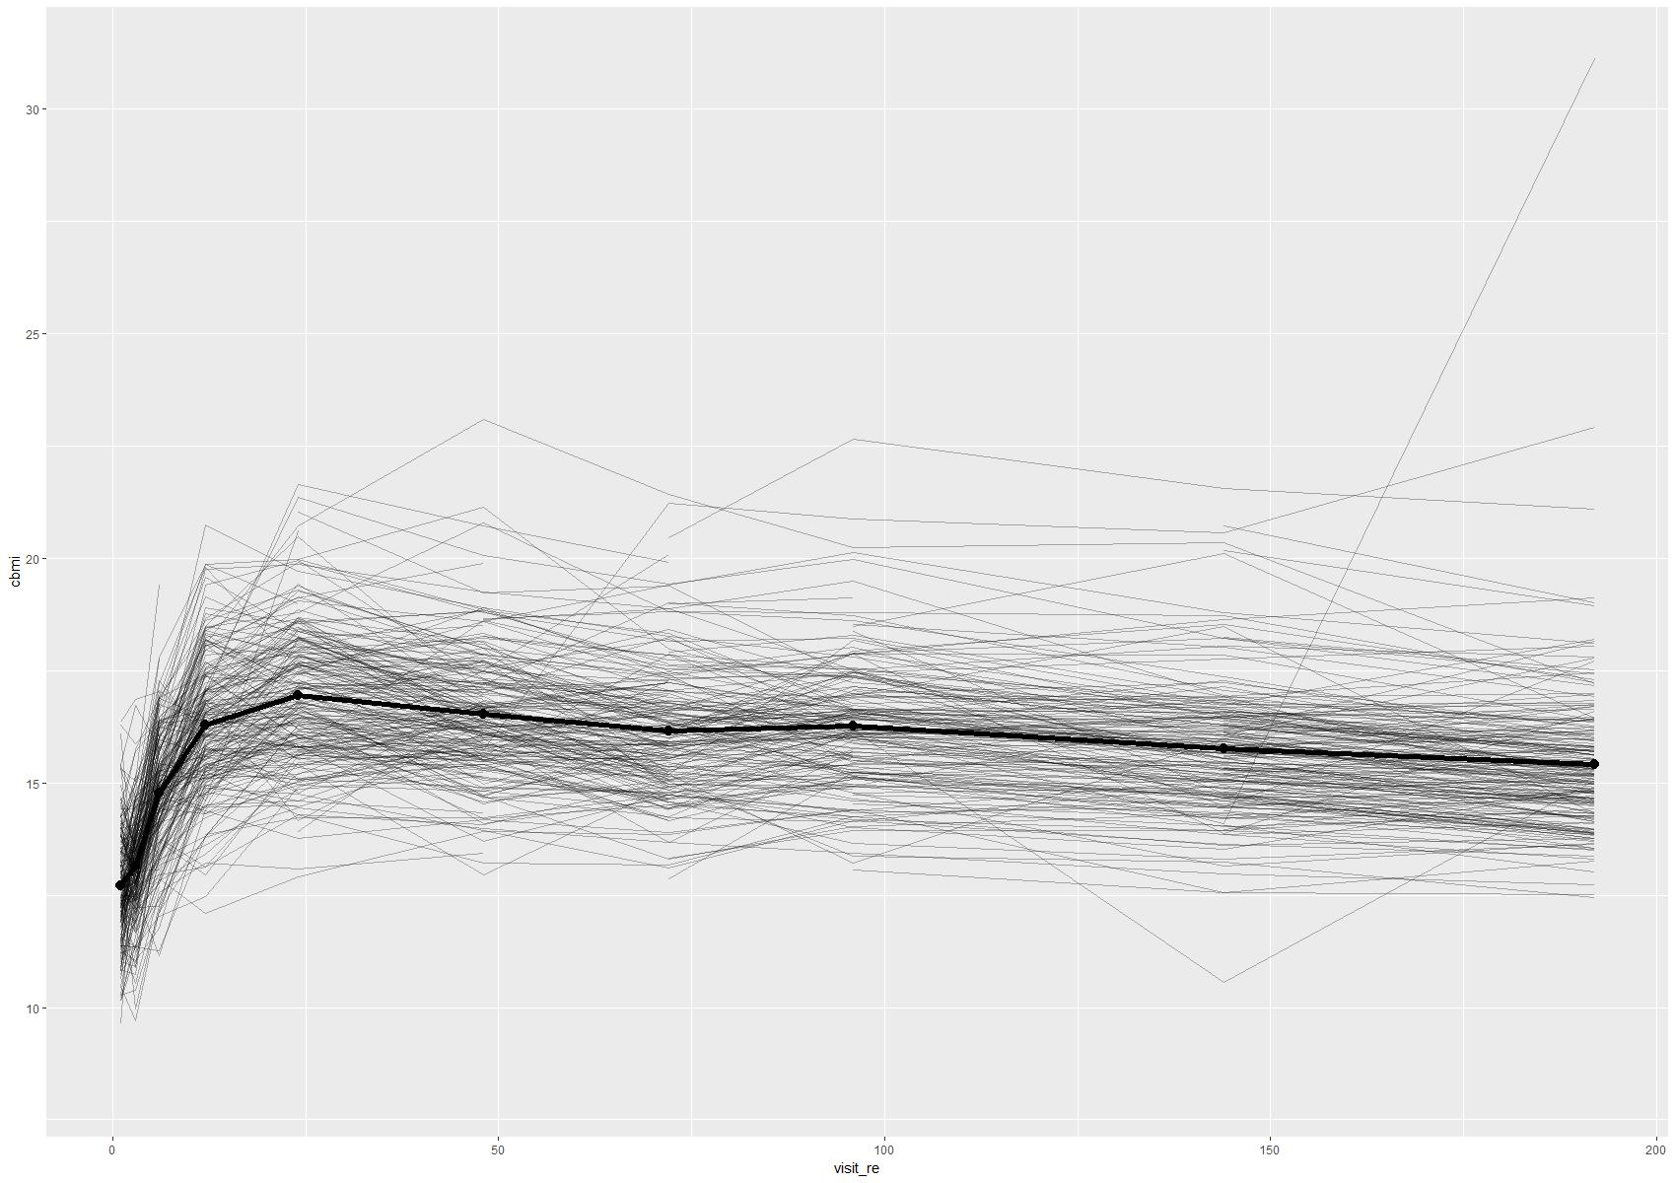
Age vs. BMI
First derivative = 0
BMI at zenith
Age at zenith

Slide 2
Mixed effect model with fixed effects given by a truncated cubic polynomial spline for age with child-specific random intercepts and linear age slopes:
BMI(t_{ij}) = (β₀+b_{0i})+(β₁+b_{1i})*t_{ij}+ β_{2*}t_{ij}² + β_{3*}t_{ij}³ + γ₃*(t_{ij}-t₀)³*I(t_{ij}>t₀)+ε_{ij}
First derivative:
BMI⁽¹⁾(t_{ij}) = (β₁+ b_{1i} )+2*β_{2*}t_{ij}+ 3*β_{3*}t_{ij}+ 3*γ₃*(t_{ij}-t₀)²*I(t_{ij}>t₀)
Age at zenith
BMI at zenith
Find roots!
For each child:
calculate BMI at age at zenith

